Slide 1

Speaker Slide Set on DOAC Dipstick
„Basics“
Point of Care Testing of
Direct Oral Anticoagulants (DOAC)
For healthcare professional use only!
© 2020 DOASENSE GmbH, Heidelberg. All rights reserved.

Slide 2

What happens in an emergency case?
unconscious
No relatives
shock / confusion
DOAC?
stroke
Major bleeding
Urgent surgical internvetion
Laboratory | POC
Specialized diagnostic ⇨ not avaliable in every laboratory Turn around time 40 min or longer | Routinely available assays such as PT and aPTT inadequate to determine DOACs

Slide 3
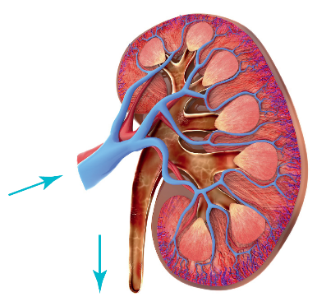
Why to determine DOACs from urine ?
DOACs are excreted between 25% and 80% by glomerular filtration of kidneys into urine
Urine dos not contain blood cells or proteins compared to blood or plasma, that may interact with testing of DOACs
Concentration of DOACs in urine much higher compared to plasma
Urine as a medium to determine sensitively und specifically DOACs
Harenberg J et al:
Semin Thromb Hemost 2015; 42; 228-36
Clin Chem Lab Med. 2016;54:275-83
Semin Thromb Hemost 2019;45:275-84

Slide 4
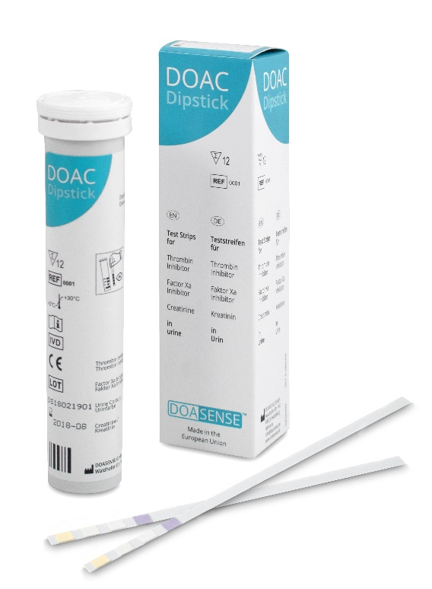
DOAC Dipstick
Only available POC Test for DOACs on the market
    Test strips to exclude presence of DOACs in urine
    Valid results available within 10 minutes
    Simple test procedure in analogy with other urine test strips
    24/7 available
    Can be performed everywhere

Slide 5
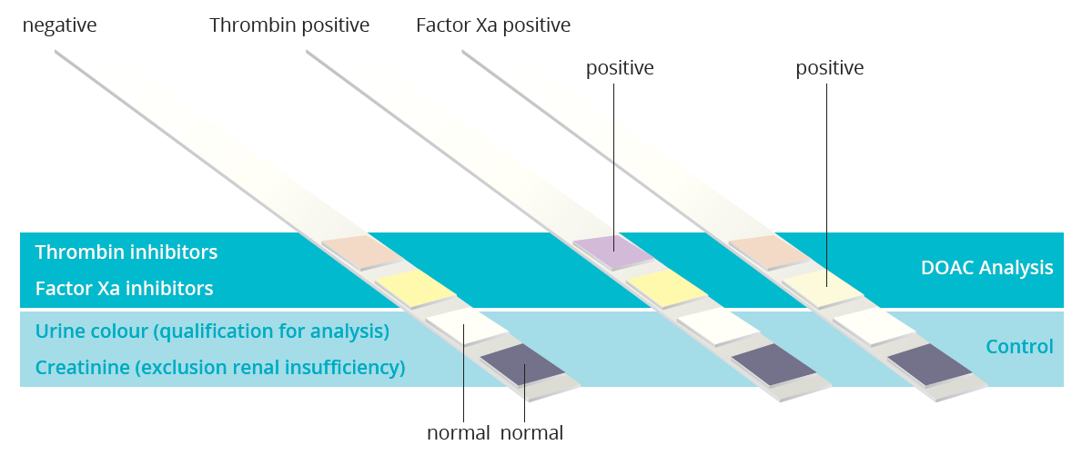
Parameter of DOAC Dipstick

Slide 6
Advantages of DOAC Dipstick
Test result is rapidly available, within 10 min.
Specific, sensitive, easy to carry out
Simple and visually interpretable
Test differentiates between factor Xa and thrombin inhibitors
Checking the validity of the test by means of test fields for creatinine and urine colour
No interaction with heparins and VKA
Depending on the result of the DOAC Dipstick, only one laboratory test for either factor Xa or thrombin inhibitor required
Harenberg J, Semin Thromb Hemost. 2019;45:275-84

Slide 7

Indications for & Benefit of DOAC Dipstick
Negative predictive value > 95%:
    Unconscious patient
    Overt major haemorrhage
    Suspicion of a major bleed
Positive predictive value >95%
  Administration of
    a specific antidote or
    plasma preparations
Speeds up medical decision process
  Fibrinolytic therapy
  Acute surgical intervention
  spinal anaesthesia
  Compliance
Harenberg J, et al. Thromb Haemost. 2019 Nov 8. doi: 10.1055/s-0039-1700545. [Epub ahead of print]

Slide 8
Examples for medical decision processes of DOAC Dipstick
Major haemorrhage
    Absence of DOAC: no antidote, no plasma preparations
    Presence of DOAC: probably antidote or plasma preparations and/or additional diagnostics and medical therapy
Indication for surgical interventions
    Absence of DOAC: perform intervention
    Presence of DOAC: surgical intervention according bleeding risk, wait until normalisation of coagulation values, administer antidote if indicated
Harenberg J, Semin Thromb Hemost. 2019;45:275-84

Slide 9
Examples for medical decision processes of DOAC Dipstick
Neuraxial anaesthesia
  Absence of DOAC: perform neurexial anaesthesia
  Presence of DOAC: neurexial anaesthesia doubtful: probably laboratory testing and / or postpone surgery or use general anaesthesia
  According result with DOAC Dipstick only one laboratory test for either factor Xa or thrombin inhibitor necessary
Harenberg J, Semin Thromb Hemost. 2019;45:275-84
Harenberg J, Beyer-Westendorf J, et al. Thromb Haemost. 2019 Nov 8. doi: 10.1055/s-0039-1700545. [Epub ahead of print]

Slide 10
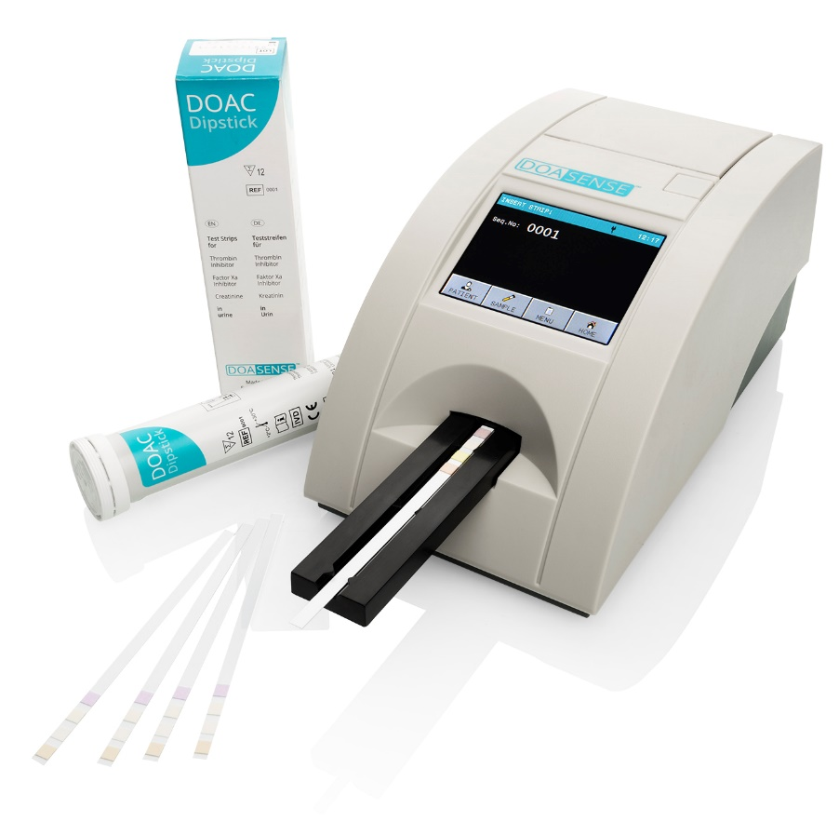
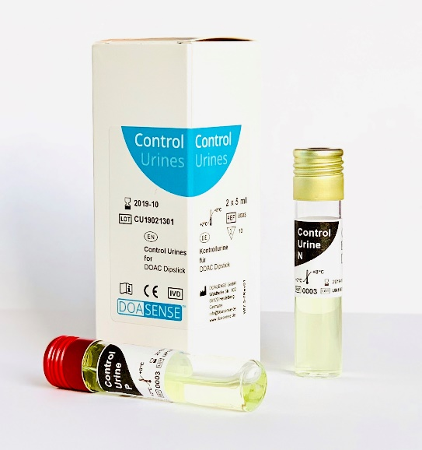
DOASENSE Product family
DOAC Dipstick test strips
(12 strips per pack)
CE mark since 2018
DOASENSE Reader
for DOAC Dipstick
CE mark since 2019
DOASENSE Control Urines
one positive and negative control per pack CE mark since 2019

Slide 11
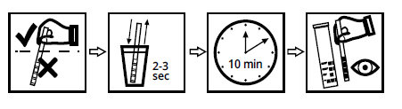
Test procedure – use of DOAC Disptick
Immerse the test strip in the urine for 2 to 3 seconds so that all test fields are covered with urine.
After taking the test strip out of the urine, gently wipe the excess of the urine on the back side and edges of the test strip by an absorbent paper.
Place the test strip with the back side on a smooth surface for 10 minutes. Check the time with a timer.
After 10 minutes immediately assess the colours of the test pads with the eye and compare them with the corresponding colours on the label of the container.

Slide 12
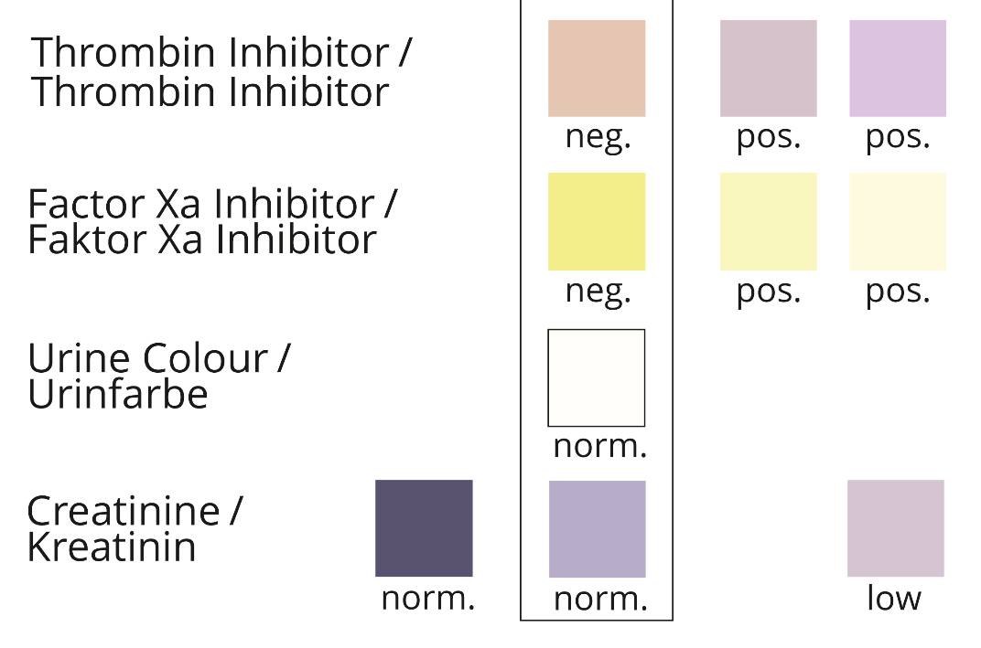
Label for visual assessment of DOAC Dipstick
Harenberg J, Semin Thromb Hemost. 2019;45:275-84

Slide 13
Examples for results of DOAC Dipstick normal findings
Harenberg J. et al Semin Thromb Hemost 2019;45:275-84

Slide 14
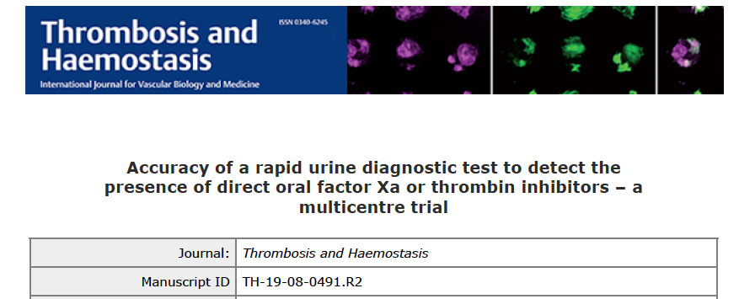
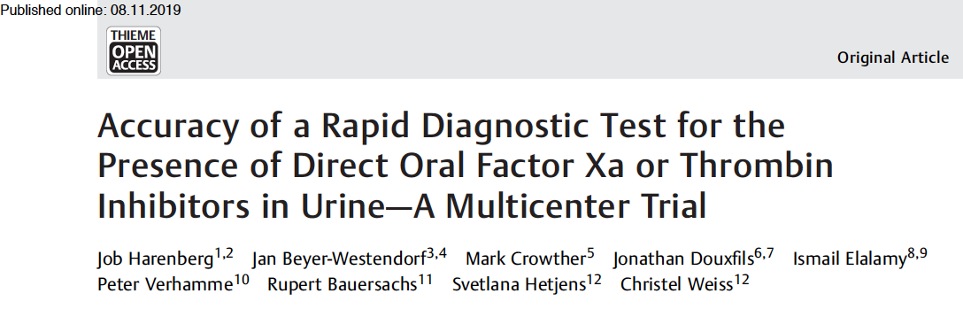
Thromb Haemost 2020; 120(01): 132-140 DOI: 10.1055/s-0039-1700545

Slide 15
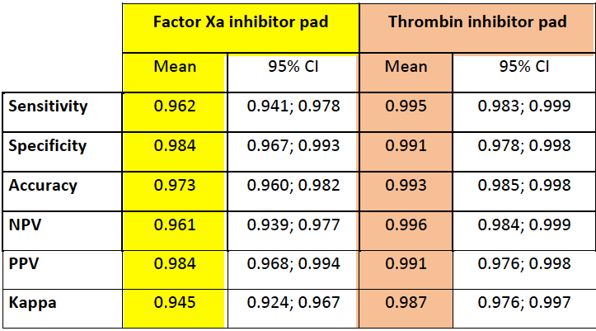
Main Results
Visual evaluation of
factor Xa inhibitor pad and of thrombin inhibitor pad

Slide 16
Summary
DOAC Dipstick test sensitively and specifically determines with high accuracy the presence of both Xa and IIa inhibitors in urine samples, if compared to the gold standard of LC-MS/MS.
High inter-centre agreement for identifying visually the results of colours of factor Xa and thrombin inhibitor pads
Thus, the DOAC Dipstick is a valuable tool to speed up medical treatment decisions

